Slide 1
INTRODUCTION TO CODING PROJECT
VISHNUSHASHANK SHESHAM

Slide 2
ROCK PAPER AND SCISSORS PYTHON PROJECT

Slide 3
OVERVIEW
Rock Paper Scissors is a simple, widely known hand game usually played between two people. Each player simultaneously forms one of three shapes with their hand: Rock, Paper and Scissors.
The game rules of this game are simple Scissors cuts Paper , Rock crushes Scissors, Paper covers Rock.
The project which I did implements this game in Python.

Slide 4
REFERENCES https://www.youtube.com/watch?v=7mTDcJ8bz_0
I used the above video tutorial to make this project and made some changes in the code.

Slide 5
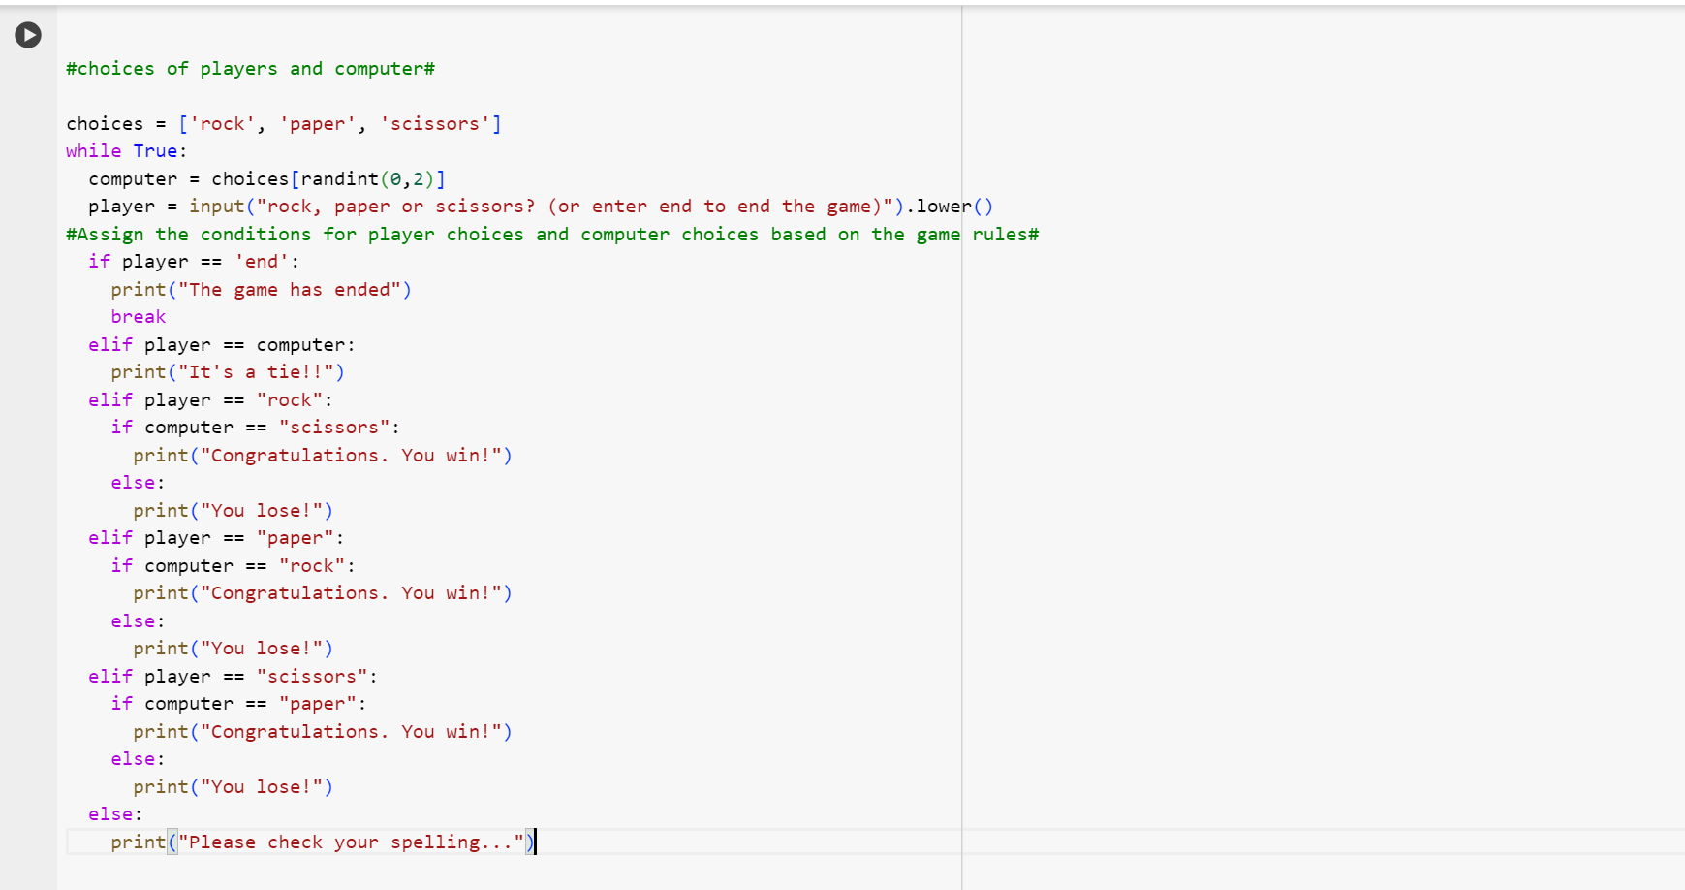

Slide 6
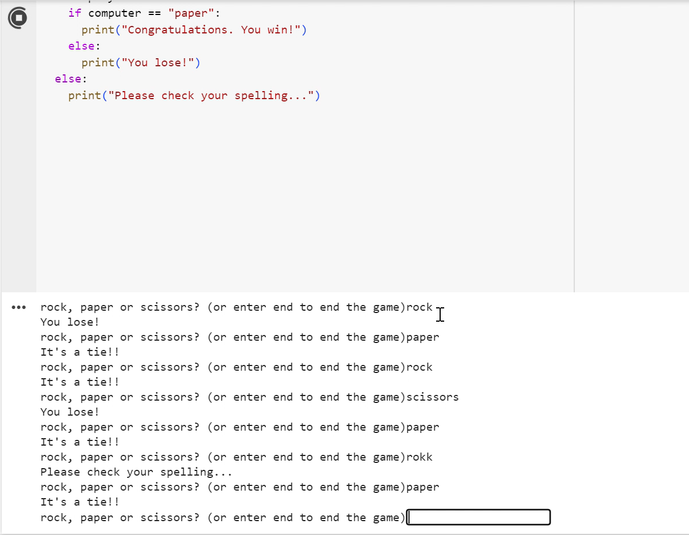

Slide 7
WHAT I HAVE LEARNT
I had lot of fun making this project. As a beginner for programming, I had lot of fun making this project.
The use of while loop for continuous gameplay.
Importing randint function from the random module in python.
I had a better understanding for usage of if, elif, else conditions in python.
Generating a random choice for computer using randint function.

Slide 8
THANK YOU

